Slide 1

美安香港超連鎖™
Market Hong Kong UnFranchise™
HK$790
讓你獲得所有
You Get Everything For HK$790

Slide 2
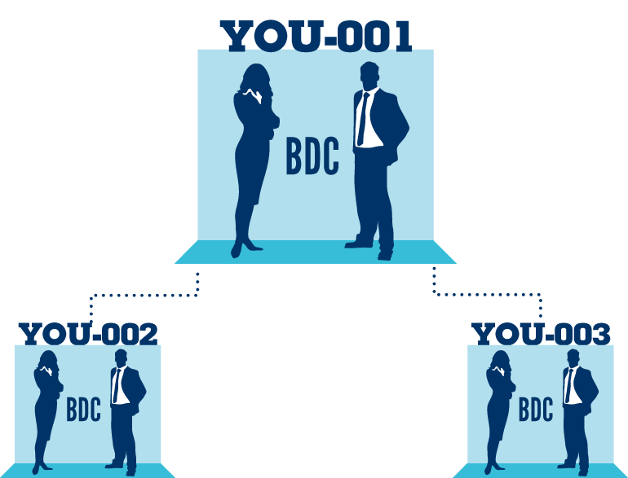
你的入門資料套裝包括
YOUR SUBSCRIPTION INCLUDES:
超連鎖™事業帳戶
專業手冊
起步指南手冊
Powerline月刊（超連鎖創業專刊）
會議聯盟系統的支援
獲得經驗豐富的超連鎖店主培訓與指導
UnFranchise™ Business Account
Career Manual
Getting Started Guide
Monthly Powerline Magazine
Training and Seminar System
Coaching and Mentoring by
Experienced UnFranchise Owners

Slide 3

美安香港超連鎖™
Market Hong Kong UnFranchise™
HK$790
你可以得到更多!
But you get so much more for
$790!

Slide 4


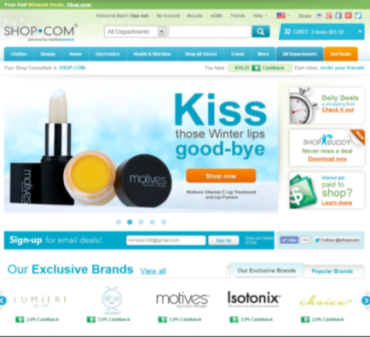
美安香港超連鎖™
Market Hong Kong UnFranchise™
你可以得到 HK.SHOP.COM入門網站
銷售及推廣你的產品!
你得到一隊專業的科技資訊團隊
支援不斷的發展
You get a SHOP.COM website to sell and promote your products!
You get a team of
IT professionals that are doing
ongoing development

Slide 5


美安香港超連鎖™
Market Hong Kong UnFranchise™
SHOP.COM的每年營運開支
是數以千萬元計算
加上要擁有SHOP.COM 這個域名，
是數以千萬元計算
It costs tens of millions of dollars per year to run SHOP.COM.
Plus, not to mention, to own a domain like SHOP.COM would cost
tens of millions of dollar

Slide 6

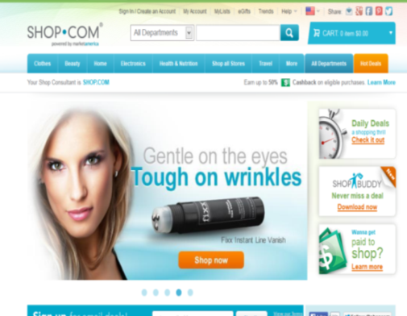


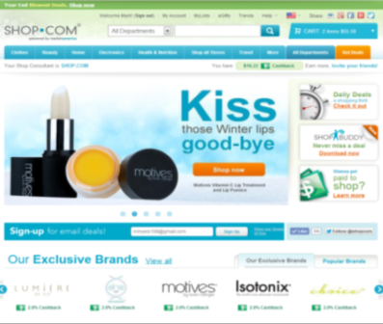
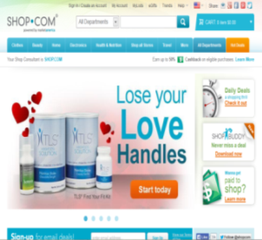
全新HK.SHOP.COM即將推出 !
A new HK.SHOP.COM homepage to be launched !

Slide 7
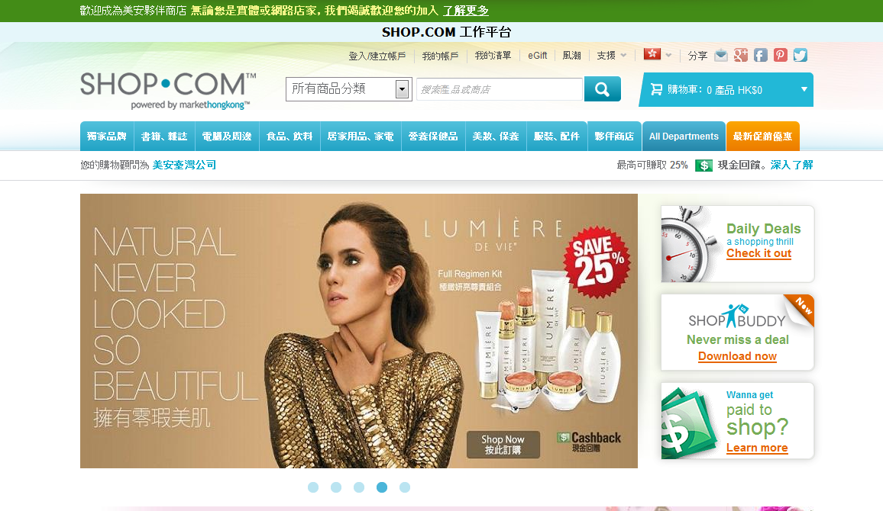


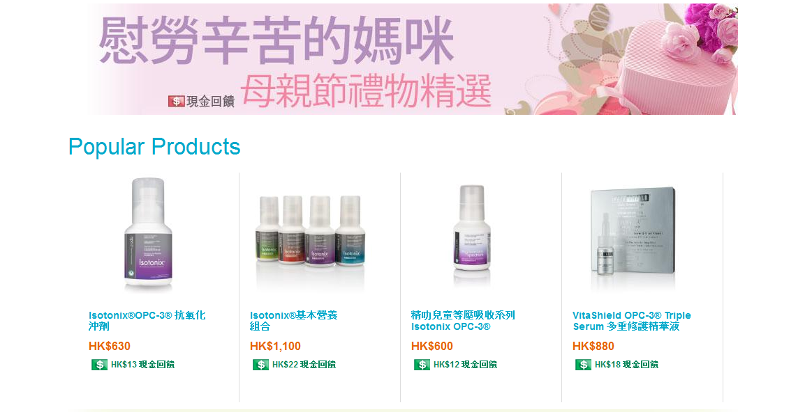
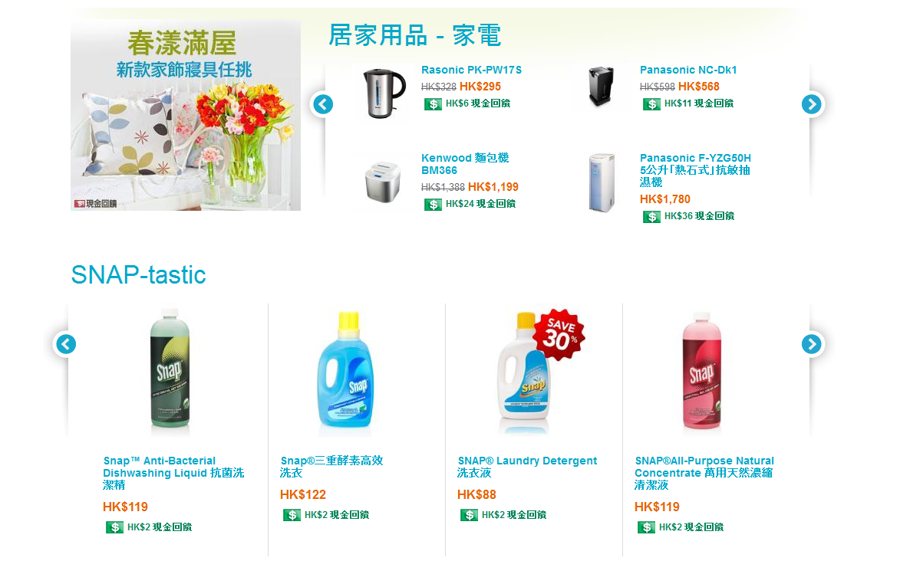
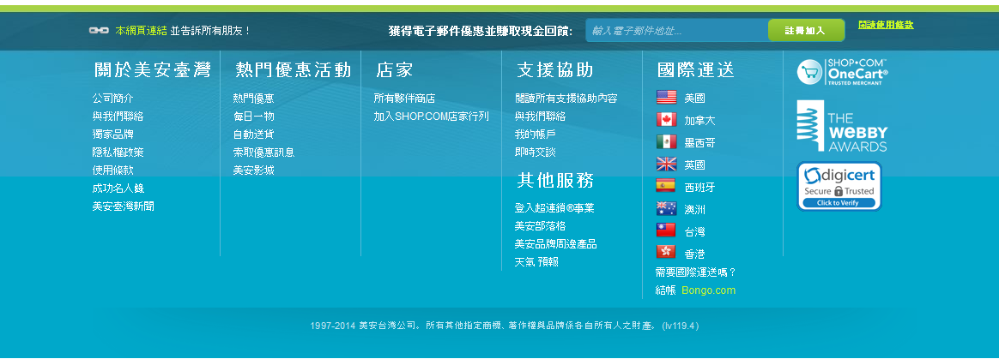
美安香港公司
特別優惠
購物驚喜
立即查看
尊賞卡
盡享Cashback
查看詳情
如何可以
消費即賺？想知更多
暢銷產品
SNAP 推介

Slide 8



美安香港公司
薑黃精華 ─
補肝排毒配方
特別優惠
購物驚喜
立即查看
將身體毒素排出
尊賞卡
盡享Cashback
查看詳情
如何可以
消費即賺？想知更多
暢銷產品

Slide 9
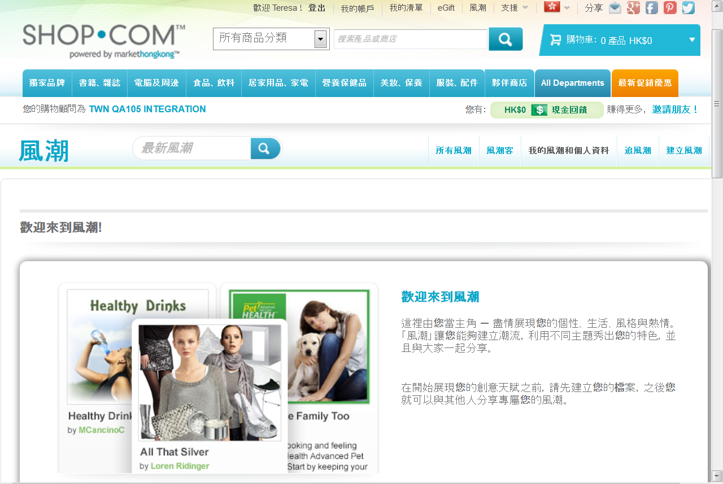

Slide 10
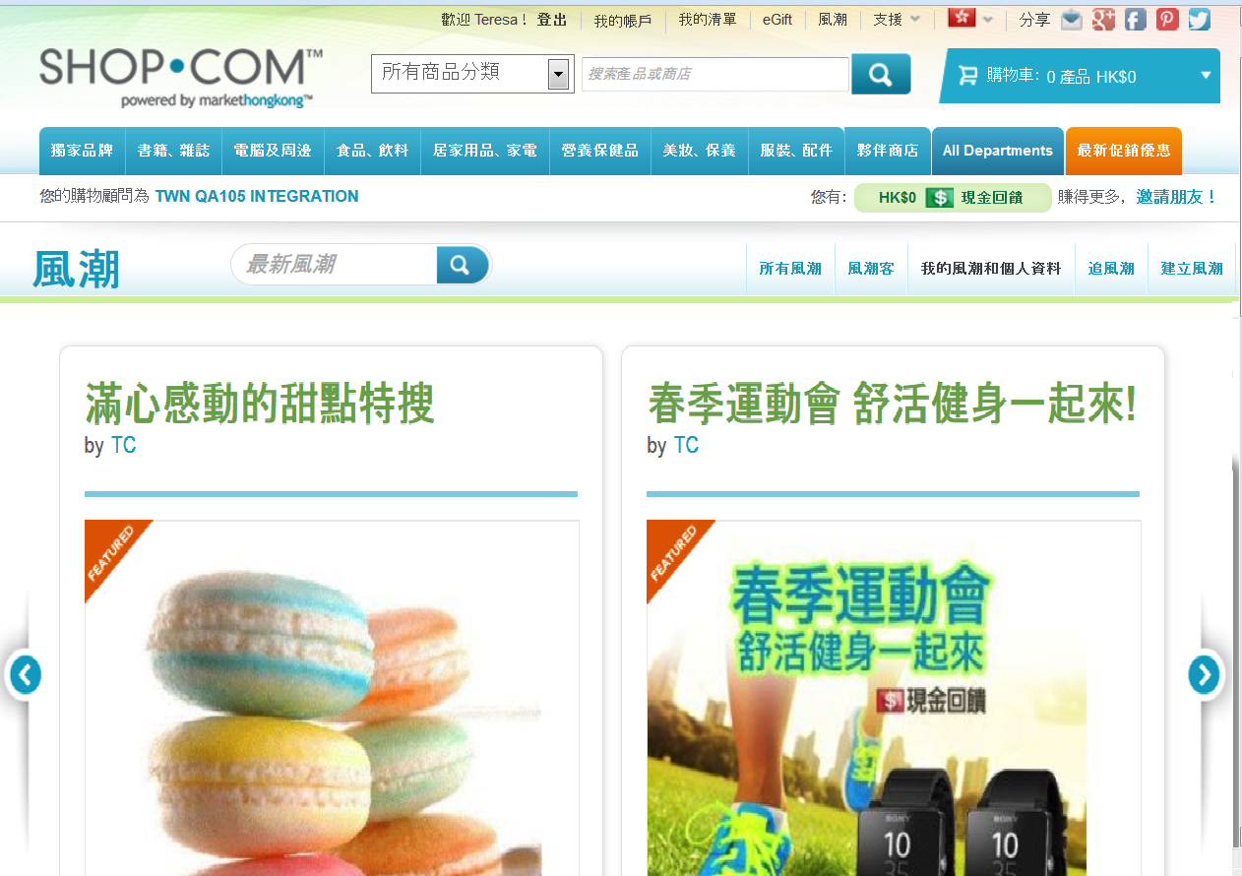

Slide 11
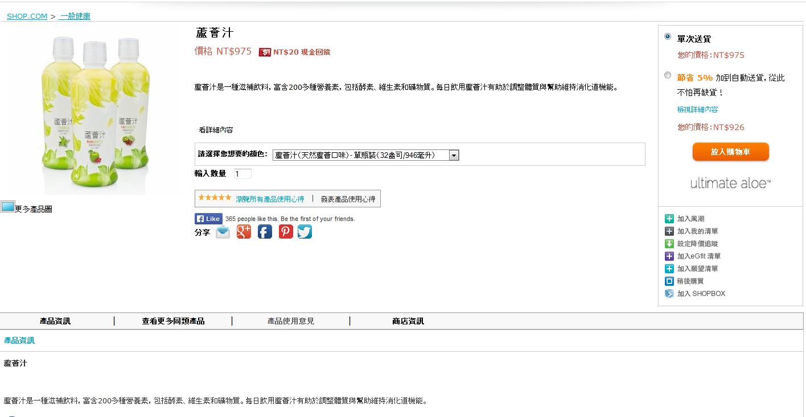


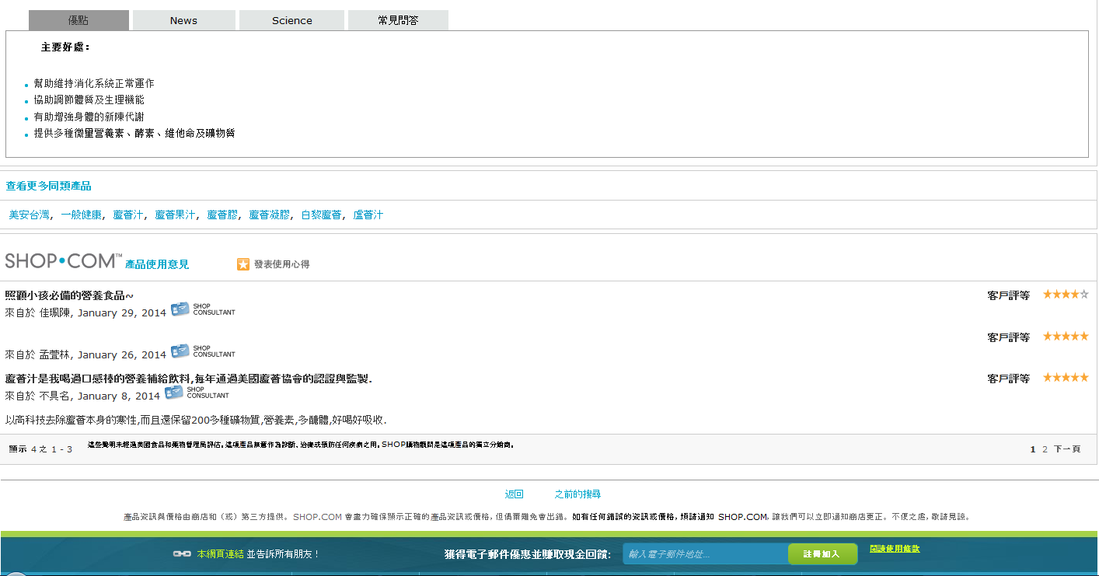
Ultimate Aloe™ 蘆薈汁
Ultimate Aloe™ 蘆薈汁

Slide 12

具影響力的顧客評論就在HK.SHOP.COM
Powerful customer reviews on HK.SHOP.COM

Slide 13

顧客評論對消費決定
如此重要的原因
Why are customer reviews so important
to consumer decisions to purchase.

Slide 14
顧客評論 Product Reviews
63%的顧客較喜歡於有顧客評論的網站消費。
根據美國網上短片瀏覽博覽會的互聯網使用者調查，顧客評論比產品介紹的可信程度明顯較高 (高出接近12 倍) 。
讓搜尋器找到富新鮮感和獨特的內容 - 搜尋器蜘蛛程式傾向搜尋經常更新不同內容的網站，而顧客評論正好是吸引更多內容更新的方法。
63% of customers are more likely to make a purchase from a site which has user reviews
Consumer reviews are significantly more trusted (nearly 12 times more) than product descriptions, according to a survey of US internet users by online video review site EXPO.
Fresh, unique content for search engines - Search engine spiders like unique content that is regularly updated, and user reviews are a great way to attract more content.

Slide 15



同時包括 The Package Includes
免費
Free
一個享有盛名的網站 One Prestigious Site

Slide 16
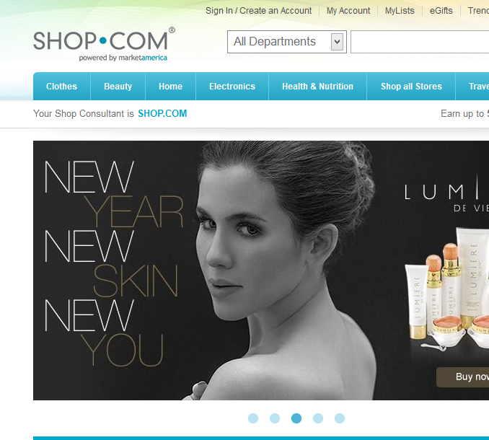
等等!
還有更多
WAIT!
THERE IS A LOT MORE!
你知道HK$790當中，是包括我們可運送到全球超過200個國家的嗎？
Did you know that as part of your HK$790, we will also ship to over 200 countries around the world?

Slide 17
HK$790還可以有什麼
Where else would get all of this for $HK790
你想知道更多嗎？
Do you want more?

Slide 18
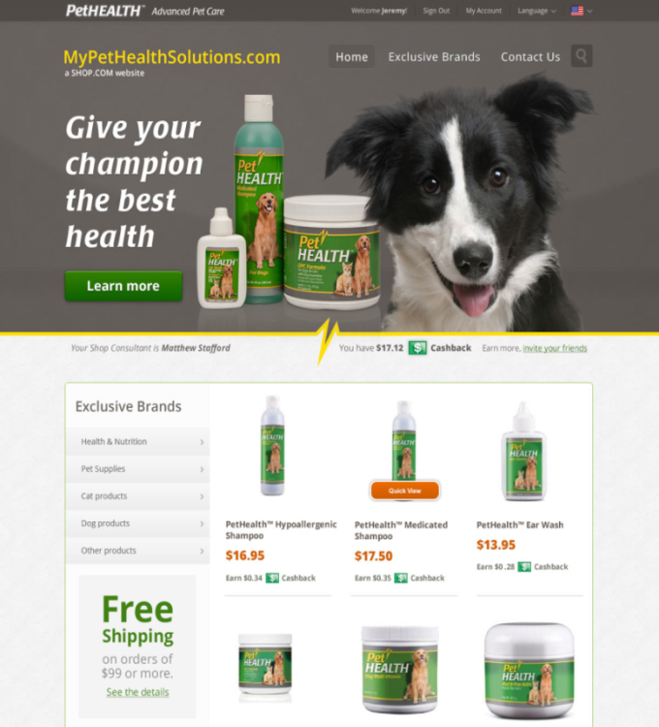
自訂迷你網站
Custom Mini-Websites
為甚麼 Why?
還有甚麼比讓你挑選網站的設計更有力？
選擇你要展示的獨家品牌或特定產品
由你自訂
Wouldn’t it be powerful to create the site you want to use?
Brand or product specific
Customized

Slide 19
自訂迷你網站
Custom Mini-Websites
為甚麼 Why?
特定的產品話題
如motives.com.hk 般強勁
介紹其中的產品，然後打開話題的關係日趨密切
Product specific conversations
Power of sites like motives.com.hk
Introduce to a subset of products and then expand the conversation as the relationship grows

Slide 20

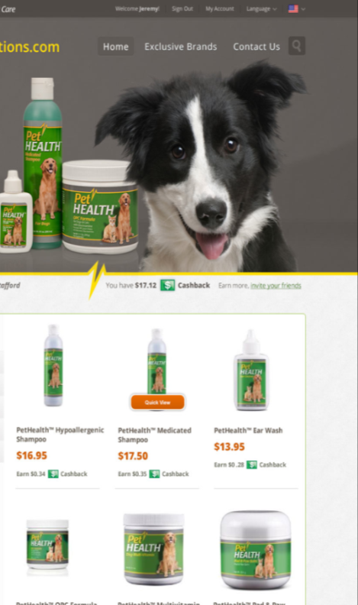
為現有的產品呈現新感覺
吸引的設計
你可以自訂
  產品
  域名
  登陸網頁
建立自訂合適的購物網站
A new take on a product we’ve had for years
Beautiful designs
You customize
  The products
  The domain
  The landing page
Building out a customized niche shopping site

Slide 21
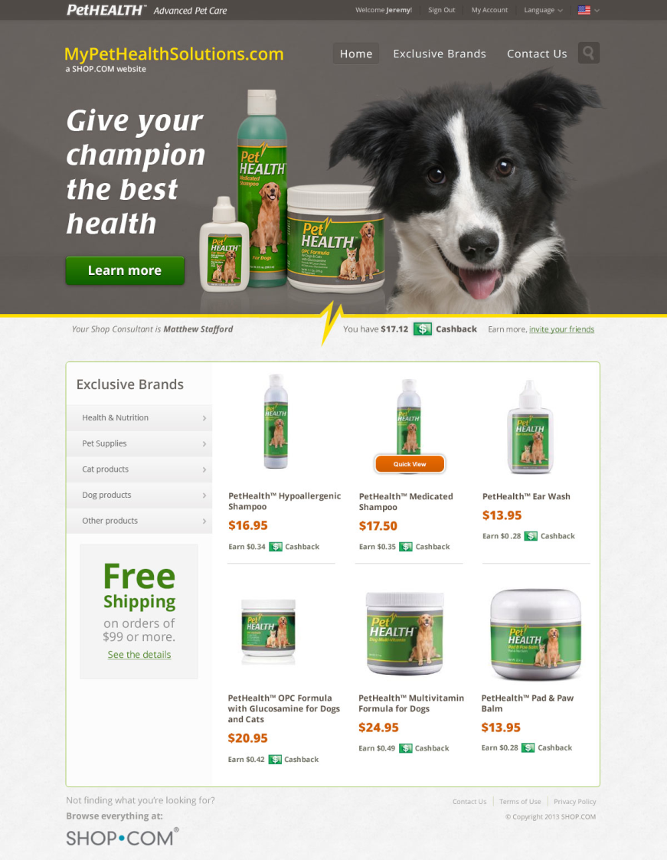
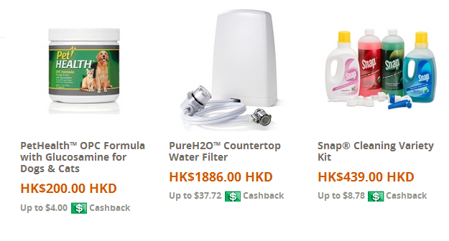


Slide 22


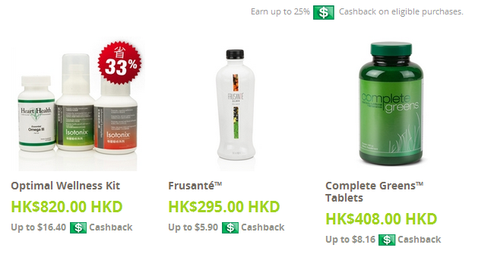

Slide 23
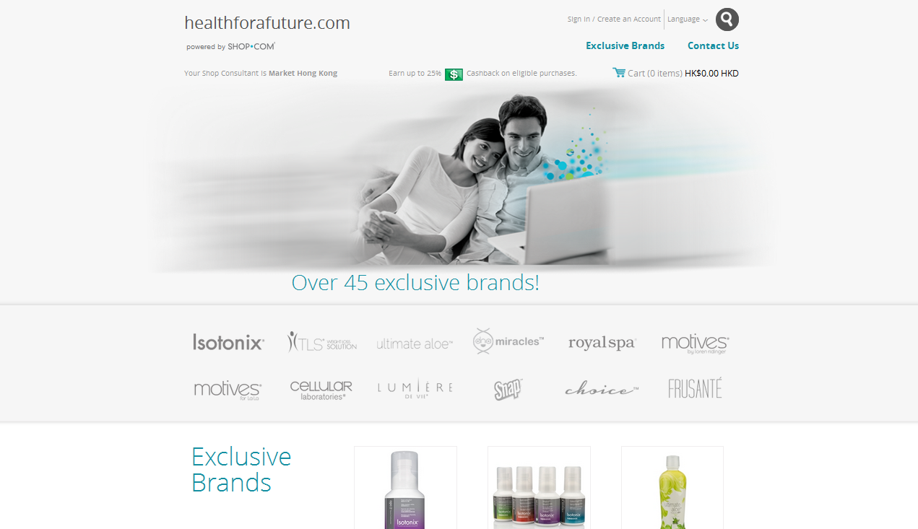

Slide 24

解決方案The Solution
這就是自訂迷你網站！
電子商務功能
非常專業
合適的主題
That’s exactly what the Custom Mini-websites are!
E-commerce enabled
Highly professional
Niche focused

Slide 25
設定
Set Up
香港經銷商可以得到
For example HKG distributor would get
每個國家都有特定的網站
你可以在所屬地區內，免費獲得一個已開展業務的美安國家網站!
你可以購買更多
Each site is specific to a country
You get one per market country in your region for free!
You can purchase more
  香港版本 HKG version, code HK6066
  台灣版本 TWN version, code T6066
  澳洲版本 AUS version, code 76066

Slide 26
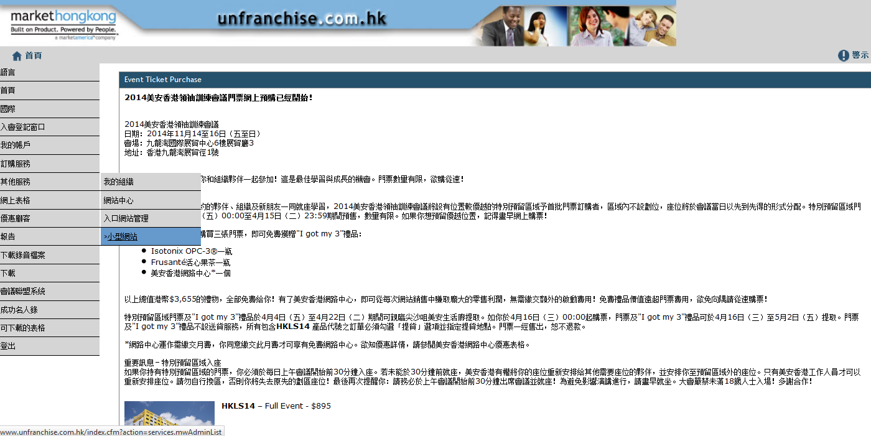

Slide 27
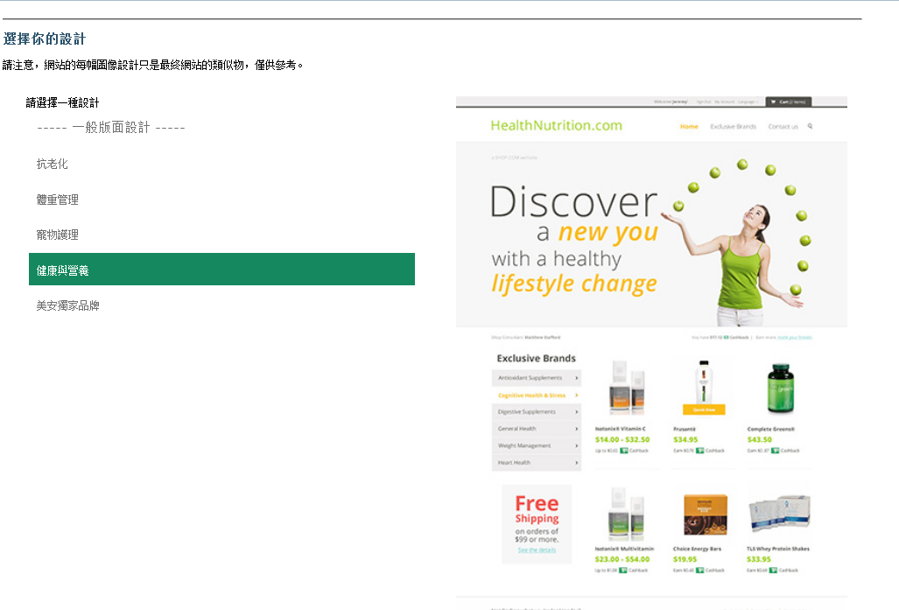
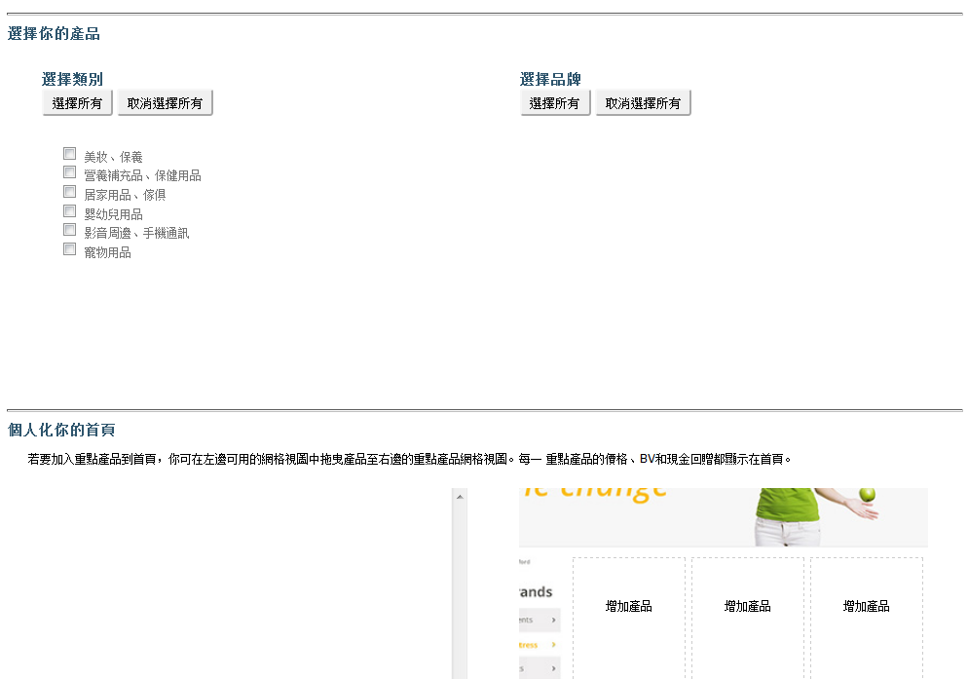
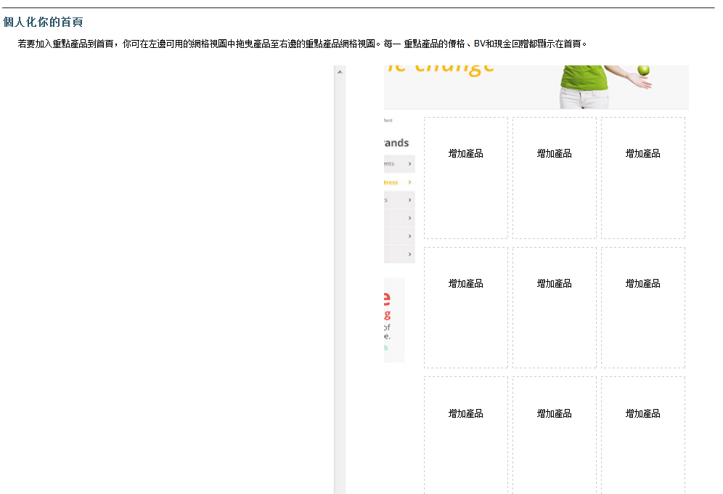
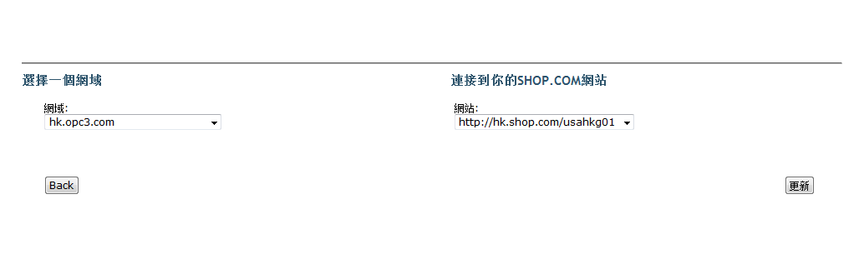
每個訂閱都個別設定
Each subscription is set up separately
選擇設計版面
Select the design
選擇產品
Select the products
選擇頁面連結
Select what goes on the landing page

Slide 28

運用你的網站獲得新客戶
在健身室，在談話中，外出活動
社交媒體、線上
建立自己的購物年金
當人問你“這是甚麼？”，就運用它！
Use your site to get new customers
At the gym, in conversations, out socially
Social media, online
Build their Shopping Annuity
Make this the follow up to “What’s that?”
接下來….
What Next?

Slide 29

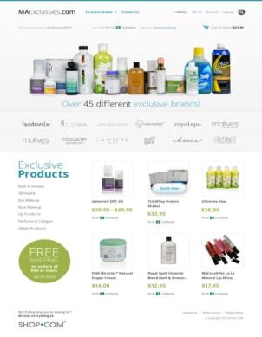
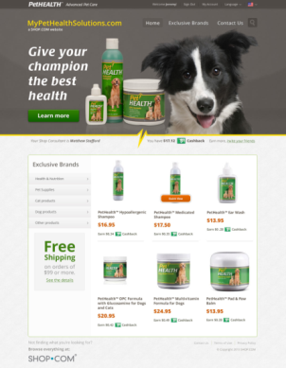


強勁新工具助你獲得新客戶
A powerful new tool
to help you acquire new customers:
  為你呈獻全新自訂迷你網站！
  Now introducing the new Custom Mini Websites!

Slide 30

For
HK$790
You’ll get
你將會獲得

Slide 31
  HK.SHOP.COM
  超過4,000件產品可供搜尋
  4,000+ products in search
  超過1,200間
  夥伴商店
  Over 1,200 partners world wide
  熱賣優惠
  Hot Deals
  現金回贈及IBV
  A Cashback & IBV Program

Slide 32

一個全面實際的消費回贈優惠計劃
給你及你的忠誠顧客
A fully functional loyalty rewards program for you and your customers.
Notes:
Chit chat with Chris:
VN: Work with HK field partners to promo PS program, let more people enjoy CB and have fun with online shopping
CW: Yes.
一個全面實際的消費回贈優惠計劃給你及你的忠誠顧客
VN: after last convention, Chris you have 為大家 work on portal enhancement，考下大家有無留意到先

Slide 33

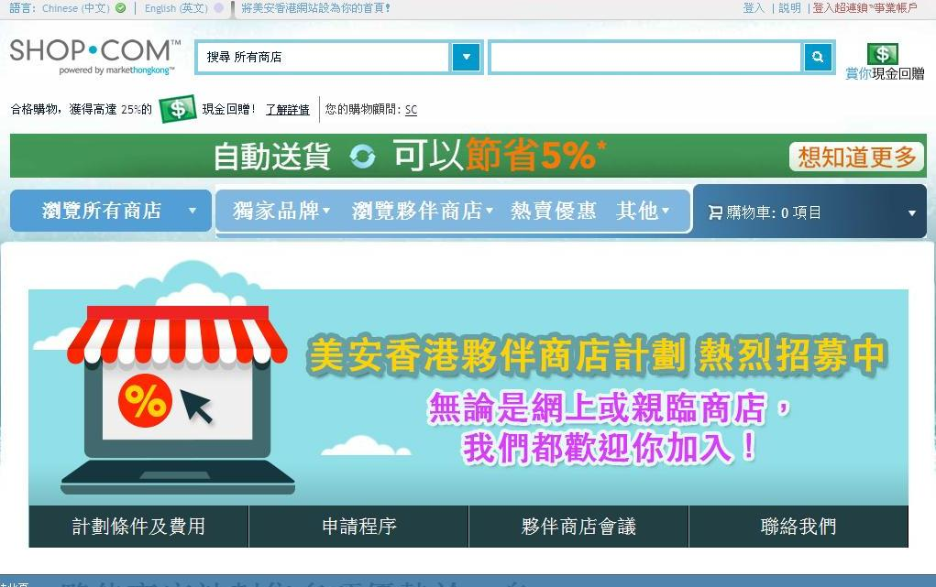
Notes:
CW: Now HK PS over 1200 stores, 進一步吸納更多 PS, 所以我地希望係更多位置同渠道有呢個訊息，於是就係大家既入門網站加左招募PS既橫額，令到大家係日常更方便將呢個 msg 去 share.

Slide 34

為優惠顧客添加更多商戶及產品
To increase stores and products for PCs
作為你的招募工具
To be your tools to recruit

Slide 35
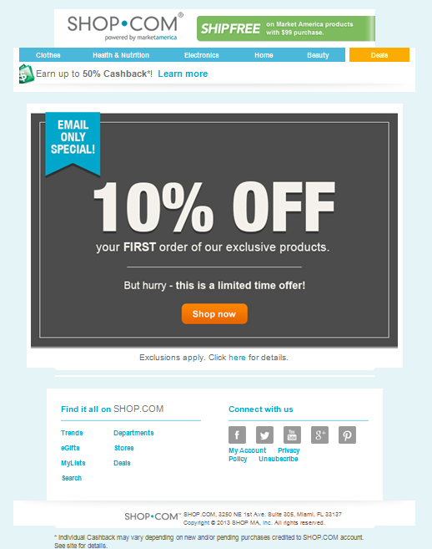

電子郵件

Slide 36
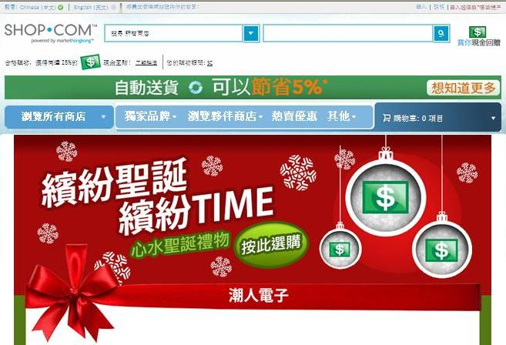
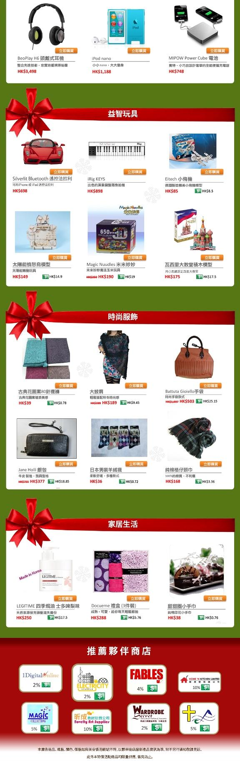

Slide 37
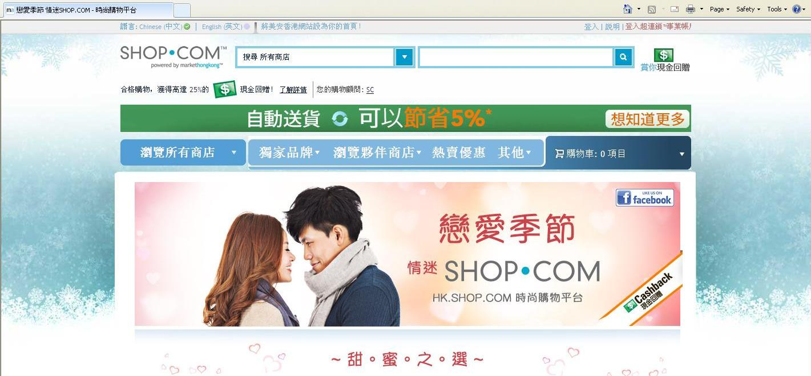
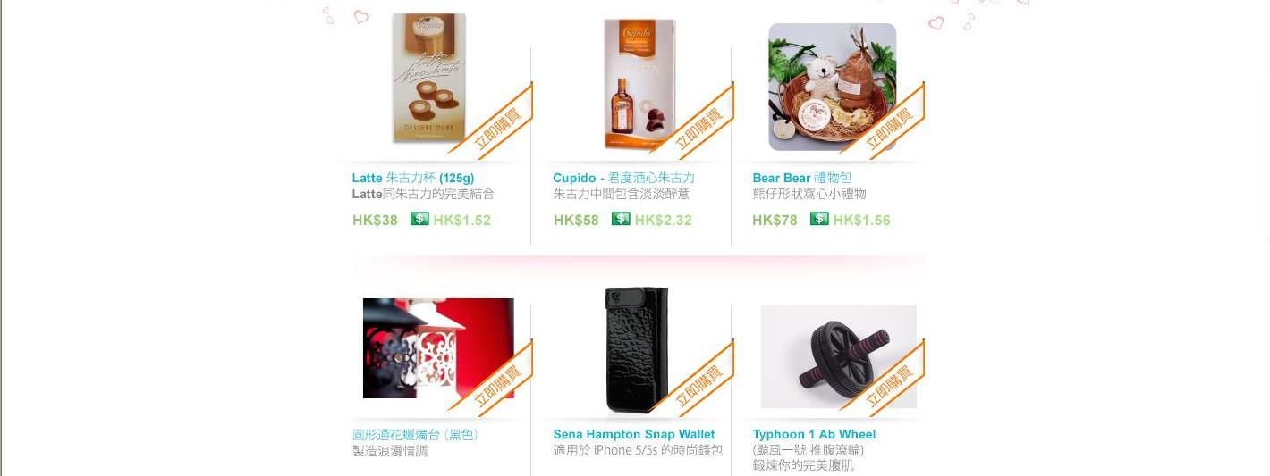
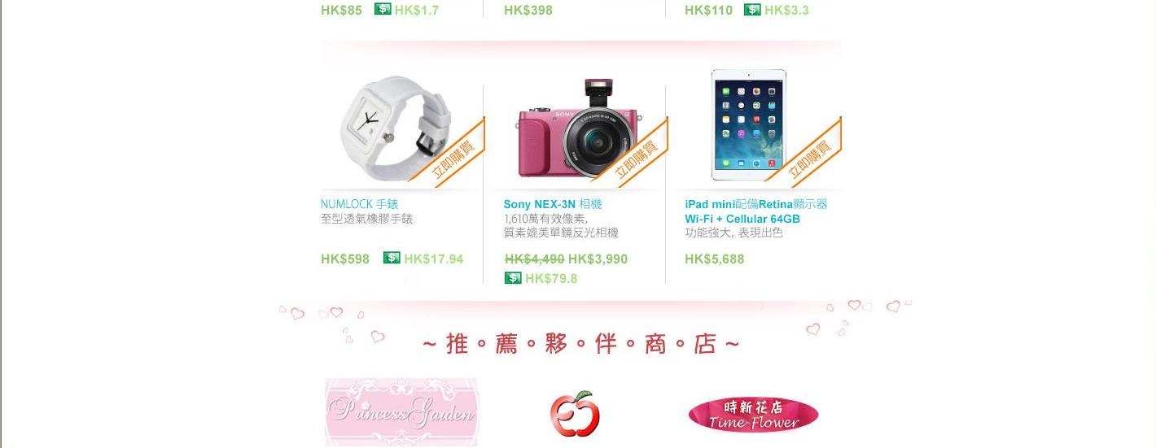
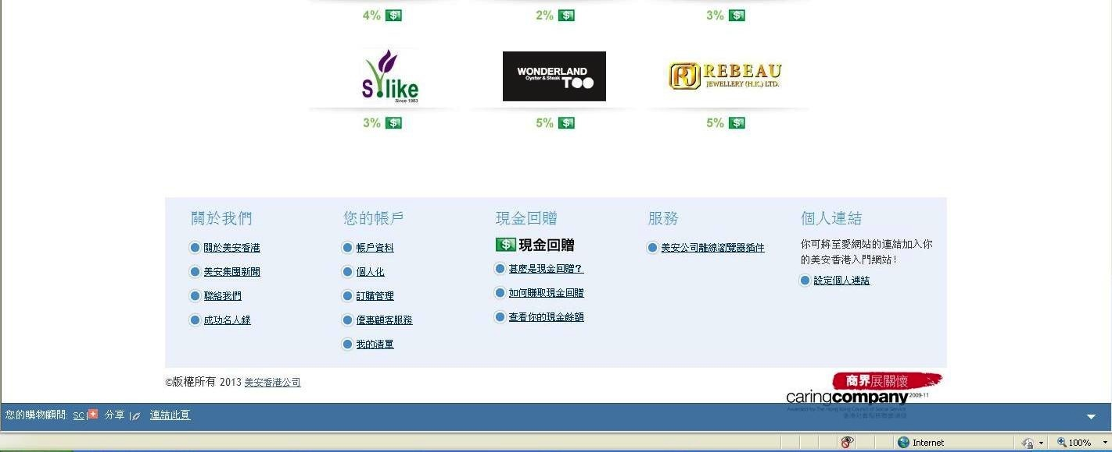

Slide 38
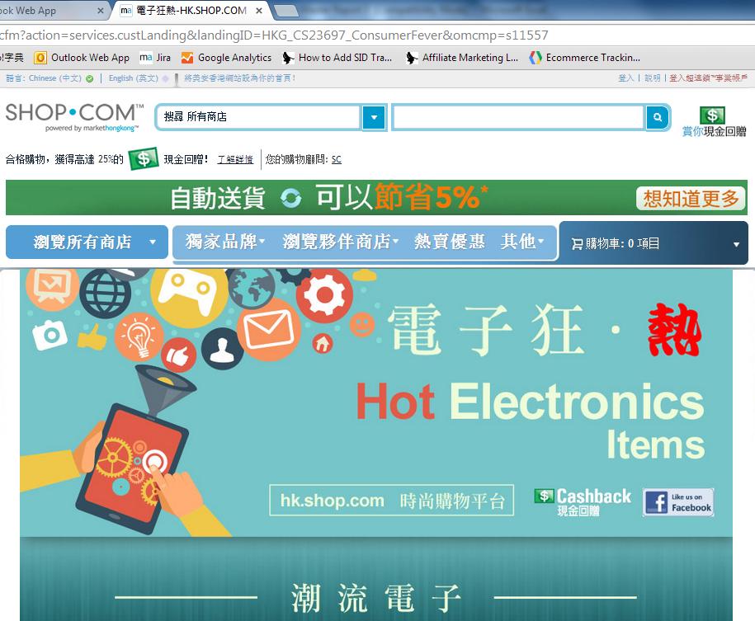
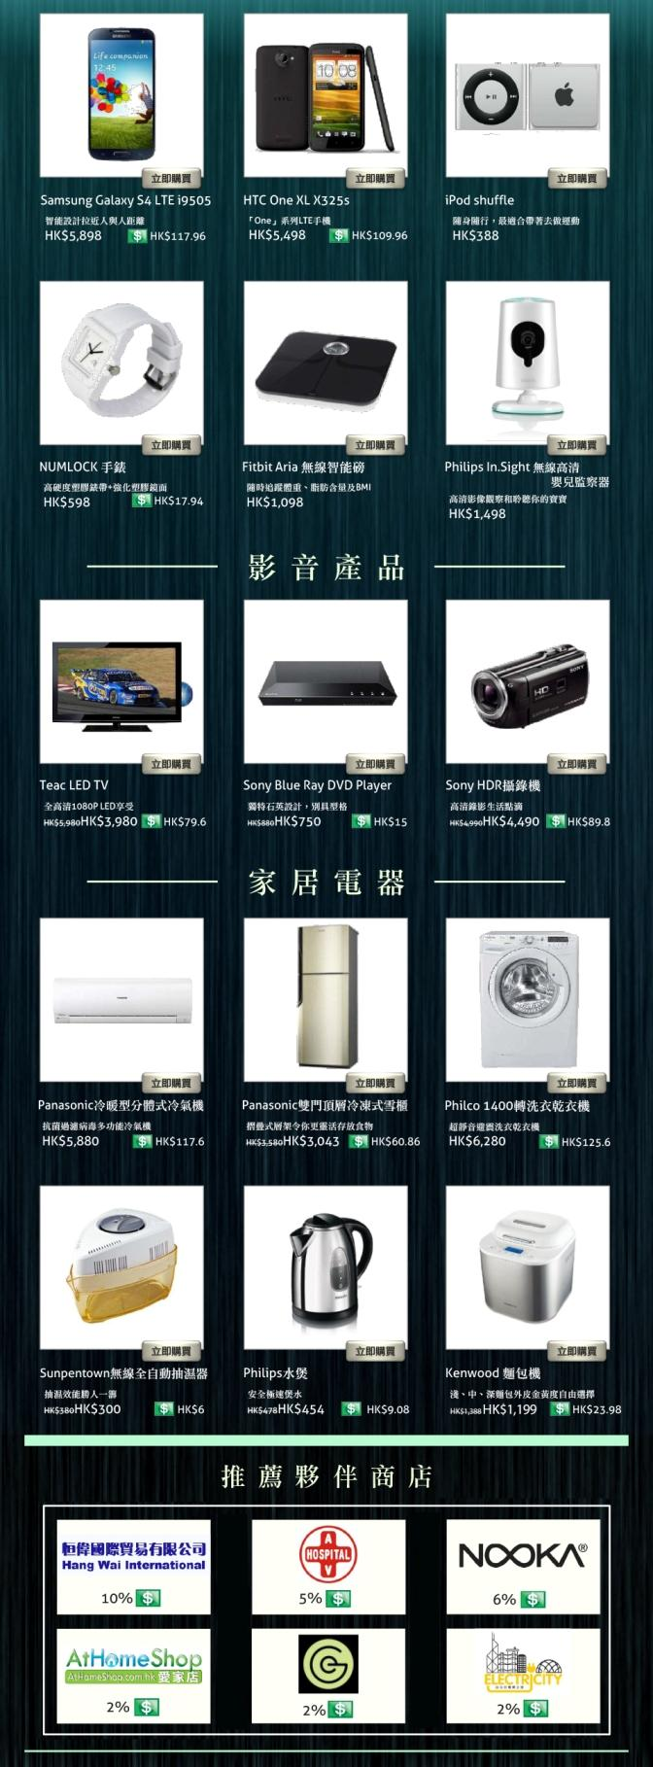

Slide 39
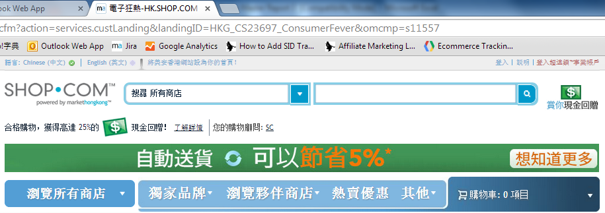
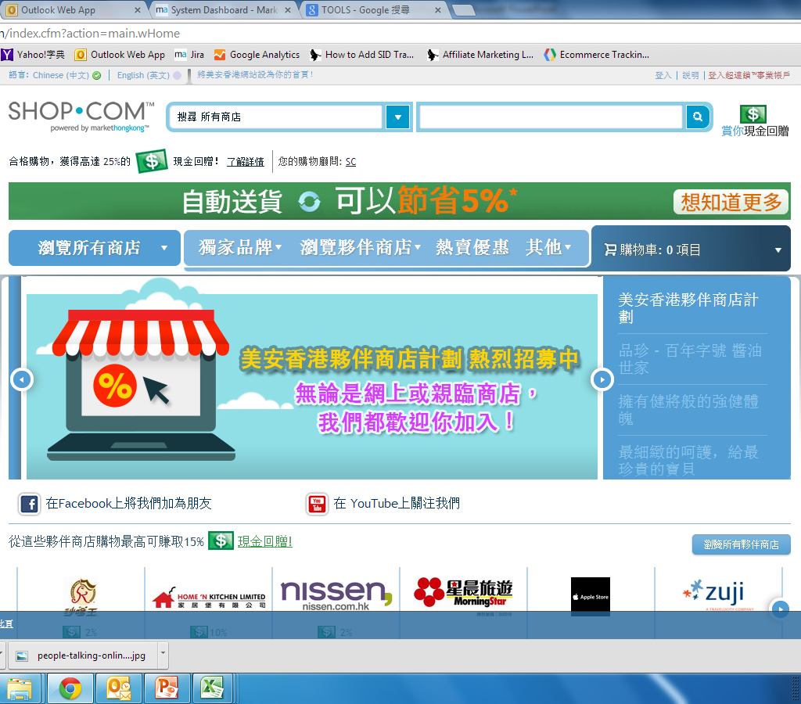
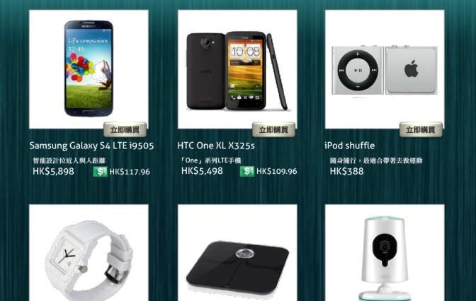
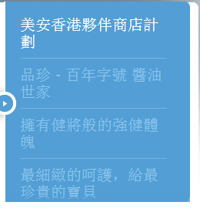



Slide 40

精選推廣令你擁有更美滿的節日
Make your festivals the best ever with little help from campaign feature
製造話題
Create talking points

Slide 41


透過現金回贈及IBV計劃，將你和你的顧客的消費轉為收入。
Converting you & your
customers spending
to earning with a
cashback & IBV program.

Slide 42




你的現金回贈計劃
Your cashback program Pays!
你和你的顧客可以獲得超過1200間夥伴商店的產品和服務
You and your customers gain access to over 1,200 partner stores

Slide 43
夥伴商店銷售額 (累計)
Partner Store Sales (Accu.)

Slide 44
現金回贈付出 Cashback Payout
於2013-14年度付出超過HK$125,000
We Paid Out HK$125,000 in 2013-14 calendar year!

Slide 45
最高銷售額 Top sales
種類 Cat. | 銷售額 Sales revenue
旅遊 Travel | $2,300,000
食品 Grocery | $1,200,000
電子產品 Consumer electronics | $1,100,000

Slide 46
最受歡迎的夥伴商店
Here are just a few popular stores that paid out the most cashback!

Slide 47

 | 2% IBV
 | 共付Paid Out
 | 超過Over 3,100 IBV

Slide 48

5% IBV | 2% 現金回贈 Cashback
共付Paid Out
超過Over 1,200 IBV | 超過Over $6,600 現金回贈 in Cashback
Satay King

Slide 49

5% IBV | 5% 現金回贈 Cashback
共付Paid Out
超過Over 600 IBV | 超過Over $7,800 現金回贈 in Cashback

Slide 50
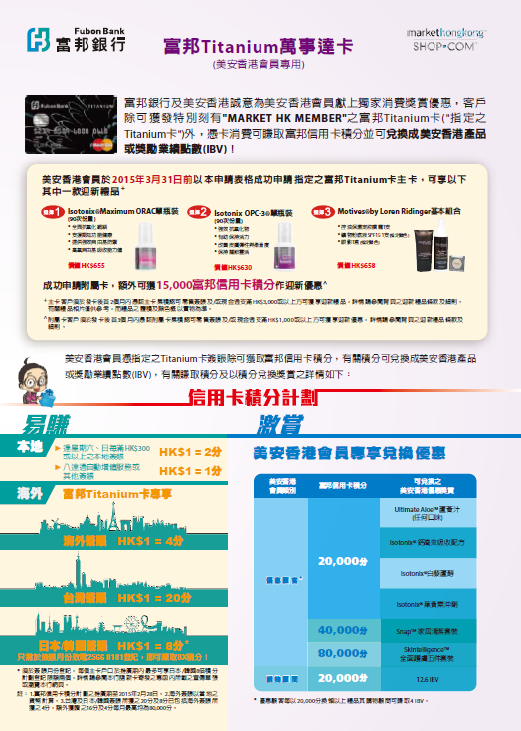
用美安香港會員專用富邦Titanium萬事達卡消費，隨時賺取IBV
Earn IBV wherever the Fubon Credit Card is used.
立即申請
Signup Today!

Slide 51

Dr. Lawrence Tsang
夥伴商店 Partner Store
高通基因利用先進的分子生物技術為本地及海外的醫療機構提供準確、快速的早期篩查及基因診斷服務。

Slide 52



www.multigene.com.hk
G4 - 胃健血檢
Gastropanel®

Slide 53


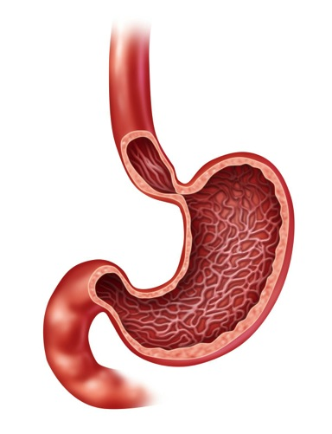
常見胃部問題 Common Stomach Diseases:
噯氣 Belch
胃氣脹 Bloating
胃酸分泌 - 過高或過低
  Gastric Acid – Too high/ low
胃酸倒流 GERD
感染幽門螺桿菌 H. pylori
胃炎 Gastritis
萎縮性胃炎 Atrophic Gastritis
胃潰瘍 Peptic ulcer
胃癌 Gastric Cancer
噴門
Cardias
胃體
Corpus
幽門
Piloro
胃竇
Antrum

Slide 54
G4 胃健血檢 - Gastropanel®:
G4 - 通過血液檢測
進行胃部健康狀況評估
噴門
Cardias
Evaluate the patients with a healthy gastric mucosa.
胃蛋白酶原 I (PG I)
胃蛋白酶原 II (PG II)
內因子
HCl
胃體
Corpus
幽門
Piloro
+
胃泌素17 (G-17)
胃蛋白酶原 ll (PG II)
胃竇
Antrum
幽門螺桿菌 IgG 抗體 (H. pylori Ab)

Slide 55
G4 - 國際註冊及専利 Registration & Patent :
整體準確度 Overall Accuracy | 85%
靈敏度 Sensitivity | 89%
特異性 Specificity | 94%
陰性預測值 Negative Predictive Value | 96%

Slide 56
G4 – 臨床定位 Positioning:
檢查方法 Method | 目的 Purpose | 樣本/ 技術 Specimen/ Tech. | 風險 Risk | 費用 HKD
幽門螺桿菌抗體 H. pylori Ab | 現在或曾經受 幽門螺桿菌感染 | 3 mL 血液 Blood | 低 Low | $
G4 胃健血檢 GastroPanel | 現在或曾經受幽門螺桿菌感染、 胃酸分泌情況、 檢查是否患上胃炎、 萎縮性胃炎、胃潰瘍、胃癌 | 3 mL 血液 Blood | 低 Low | $
碳13尿素呼氣測試 C13 Urea Breath Test | 現在是否受 幽門螺桿菌感染 | 呼氣 Breath Test | 低 Low | $
鋇餐造影 Barium Meal | 檢查是否患上胃炎、 萎縮性胃炎、胃潰瘍、胃癌 | X 光 Ray | 一般 Moderate | $$
腹部CT | 檢查是否患上胃炎、 萎縮性胃炎、胃潰瘍、胃癌 | 電腦掃描 Computerized Tomography | 一般 Moderate | $$$
胃鏡 Gastroscopy | 感染幽門螺桿菌、胃炎、 萎縮性胃炎、胃潰瘍、胃癌 | 內窺鏡 Endoscopy | 高 High | $$$

Slide 57
G4 - 臨床意義 Indications:
區分「胃酸分泌 - 過高或過低」、「胃炎」、「幽門螺桿菌」感染、「萎縮性胃炎」或正常
評估患「胃潰瘍」及「胃癌」的風險檢測
評估某些維生素 B12、礦物質和藥物吸收不良的風險
臨床藥物選擇、療效評價及疾病轉歸動態監測
也可作為不適合做胃鏡之人士的胃病輔助檢測方法
Differentiate an anacidic stomach or too much gastric acid secretion, gastritis, atrophic gastritis, H. pylori infection or normal.
Evaluate the risk of peptic ulcer and stomach cancer.
Evaluate the risk for malabsorption of vitamin B12, calcium, iron, magnesium, zinc and some pharmaceutical substances
As therapy reference and evaluation, dynamic monitoring
As an assistant test for people who are not suitable for gastroscopy.

Slide 58
怎幫助胃健康 How to improve stomach health
夏威夷螺旋藻
……含有天然脂肪酸、維他命B-12、鐵、蛋白質及人體未能製造的重要氨基酸，它還含有葉綠素及胡蘿蔔素，兩者均因為其抗氧化特質而聞名。
Hawaiian Spirulina Pacifica (HSP)
……HSP naturally contains fatty acids, vitamin B-12, iron, protein and essential amino acids that the body cannot produce. It also contains chlorophyll and carotenoids, both of which are known for their antioxidant properties.

Slide 59

怎幫助胃健康 How to improve stomach health
夏威夷螺旋藻
Hawaiian Spirulina Pacifica
Complete Greens™
全方位蔬果精華丸裝

Slide 60
G4 - 5大優點 5 Advantages
全球超過50,000名人士已使用過本檢測
Over 50,000 people have been screened by G4
1. 安全 Safe
~ 1/10 風險 Risk (只需3 mL抽血)
2. 省時 Fast
~ 1/10 時間 Time (只需花數分鐘時間)
3. 經濟 Low cost
~ 1/8 費用 Fee (HKD 880)
4. 準確 Accuracy
- 準確度 ~ 94%, 特異性 > 93%
5. 可靠 Reliable
- 已獲 FDA, CE IVD & CFDA 註冊 Registered

Slide 61




特別優惠 Special Offer for MHK
檢測禮券 Coupon: HKD 880
(1)
5%
(2)
每天首100張, 買一送一
Buy 1 get 1 free for
the first 100 coupons each day
(Only for 3rd & 4th May, 2014)

Slide 62

推廣團隊不斷為你搜尋最好的優惠，帶給你及你的顧客。
You also have a team of professional marketing merchandisers that continually find all the best deals and offers for you and your customers.

Slide 63
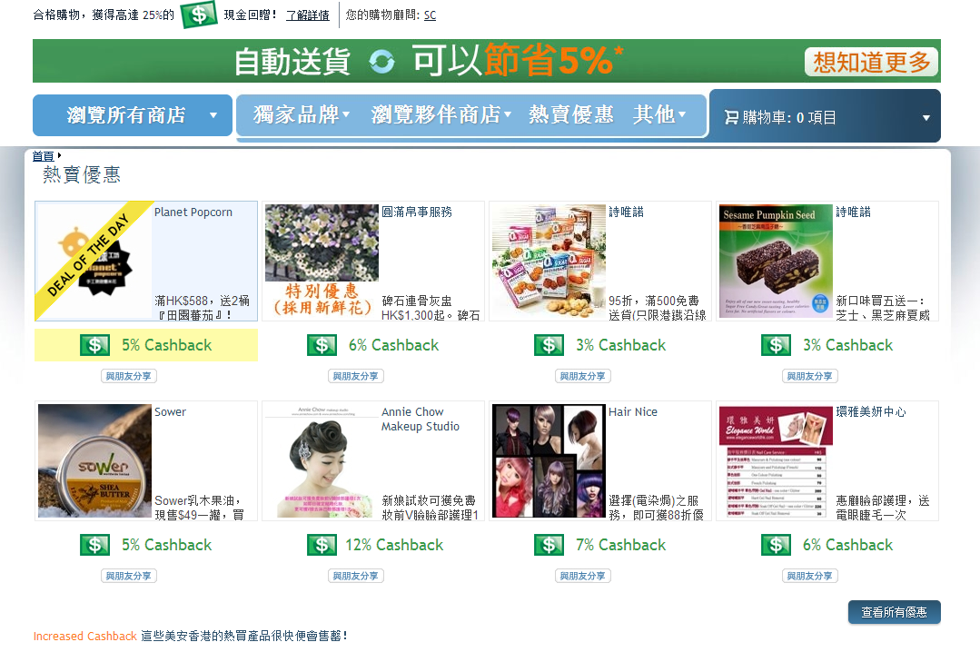

Slide 64
年會現場優惠
Convention exclusive offers

Slide 65


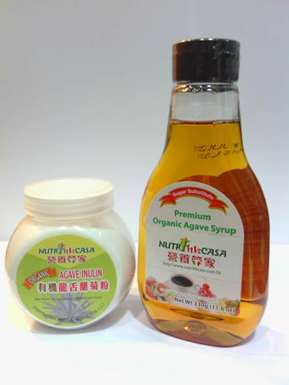
5% 現金回贈 CB
5% IBV
所有貨品
九折
10%off

Slide 66

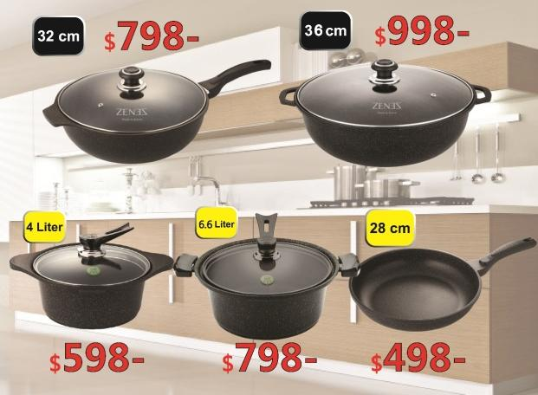
5% 現金回贈 CB
5% IBV
尚膳廚廚具系列
第2件
減$200
Less $200 for 2nd pcs

Slide 67
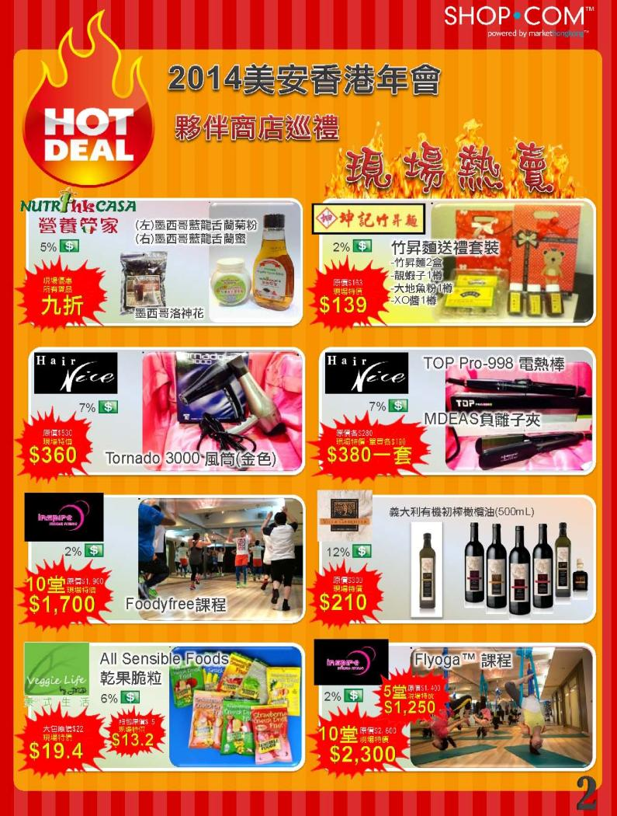
參觀夥伴商店攤位，取得現場獨家優惠！
Go By the Partner Store Booth and get all exclusive offers from our partners!

Slide 68





你可賺取現金回贈及IBV
You earn Cashback and IBV
優惠維持於一定時間內有效
Deals will be on the site for a specific period
熱賣優惠
定期更新
Hot deals update on the site periodically
熱賣優惠可於網上或親臨商店享用
Enjoy hot deals for online or walk-in purchases

Slide 69


